Slide 1









My Number Interactive Notebook
$$×$$
$$\frac{1}{2}$$
$$÷$$
$$+$$
$$−$$
$$\frac{3}{5}$$
$$7$$
Name
Class
Teacher
Term 1 Semester 1
$$5^{2}$$
$$\sqrt{9}$$
1

Slide 2
Contents
Glossary or Formula Page
Page
Date
Description
2
3

Slide 3
Tasks
24
7
30
Essential Question
Questions
Notes
Summary

Slide 4
24
7
30
Date
Directed Numbers
EQ – How do you solve problems involving directed numbers?

Slide 5
Task One
2 + 3 =
2+(-3) =
2 – 3 =
2 – (-3) =

Slide 6

Task One
2 + 3 =
2+(-3) =
2 – 3 =
2 – (-3) =

Slide 7
24
7
30
Date
Directed Numbers
EQ – How do you solve problems involving directed numbers?
What are the rules for adding and subtracting?

Slide 8
24
7
30
Date
Directed Numbers
EQ – How do you solve problems involving directed numbers?
What are the rules for adding and subtracting?
Replace two adjacent signs using the following rules

Slide 9
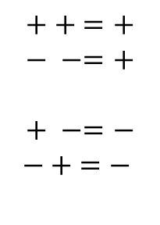
24
7
30
Date
Directed Numbers
EQ – How do you solve problems involving directed numbers?
What are the rules for adding and subtracting?
Replace two adjacent signs using the following rules
$$++ =+$$
$$− −=+$$
$$+ −=−$$
$$− + =−$$

Slide 10
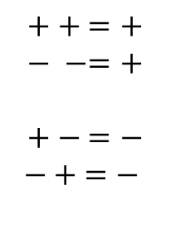
24
7
30
Date
Directed Numbers
EQ – How do you solve problems involving directed numbers?
What are the rules for adding and subtracting?
Replace two adjacent signs using the following rules
$$++ =+$$
$$− −=+$$
$$+ − =−$$
$$− + =−$$
Same sign +
different signs –

Slide 11

24
7
30
Date
Directed Numbers
EQ – How do you solve problems involving directed numbers?
What are the rules for adding and subtracting?
Replace two adjacent signs using the following rules
$$++ =+$$
$$− −=+$$
$$+ − =−$$
$$− + =−$$
Same sign +
different signs –
$−4+\left(−3\right)=$

Slide 12

24
7
30
Date
Directed Numbers
EQ – How do you solve problems involving directed numbers?
What are the rules for adding and subtracting?
Replace two adjacent signs using the following rules
$$++ =+$$
$$− −=+$$
$$+ − =−$$
$$− + =−$$
Same sign +
different signs –
Adjacent signs
$$−4+\left(− 3\right)=$$

Slide 13
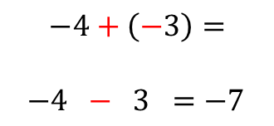
24
7
30
Date
Directed Numbers
EQ – How do you solve problems involving directed numbers?
What are the rules for adding and subtracting?
Replace two adjacent signs using the following rules
$$++ =+$$
$$− −=+$$
$$+ − =−$$
$$− + =−$$
Same sign +
different signs –
Adjacent signs
$$−4+\left(−3\right)=$$
$−4 − 3 =−7$

Slide 14

Task-two
$2×3=$
$2×−3=$
$−2×3=$
$−2×−3=$

Slide 15

24
7
30
Date
Directed Numbers
EQ – How do you solve problems involving directed numbers?
What are the rules for multiplying and dividing?
If both numbers are the same sign then the answer is positive
$$+ × + =+$$
$$− × −=+$$
Same sign +

Slide 16
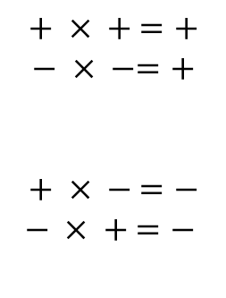
24
7
30
Date
Directed Numbers
EQ – How do you solve problems involving directed numbers?
What are the rules for multiplying and dividing?
If both numbers are the same sign then the answer is positive
$$+ × + =+$$
$$− × −=+$$
$$+ × − =−$$
$$− × + =−$$
Same sign +
If both numbers are different signs then the answer is negative
different signs –

Slide 17
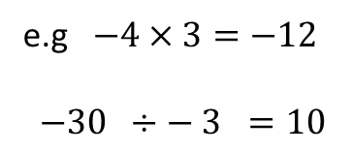
24
7
30
Date
Directed Numbers
EQ – How do you solve problems involving directed numbers?
What are the rules for multiplying and dividing?
If both numbers are the same sign then the answer is positive
$$+ × + =+$$
$$− × −=+$$
$$+ × − =−$$
$$− × + =−$$
Same sign +
If both numbers are different signs then the answer is negative
different signs –
e.g $−4×3=−12$
$−30 ÷− 3 =10$

Slide 18
Task 3
Turn to page 29 in your text books.
Complete Questions 4 to 12.
Extension:
Try question 16 or 17 on page 30.

Slide 19
Questions

Slide 20
Notes Review
24, 7 ,30
Date
Title
Essential question
Notes complete
Notes complete with colour and diagrams
Questions completed
Contents page filed in
Formula page filled in

Slide 21
Homework
Review your notes and write a summary answering the essential question.

